Slide 1
IDC Market Glance: Edge Infrastructure, 1Q21
Dave McCarthy, Max Pepper

Slide 3
IDC’s Take
Edge is a distributed computing paradigm that includes the deployment of infrastructure and applications outside of centralized datacenters as close as necessary to where data is generated and consumed.
Demand for edge solutions has created a competitive market with growth opportunities for OEMs, ISVs, and service providers:
Hardware OEMs have introduced edge specific designs in a variety of form factors with an emphasis on ruggedization, remote management, security, and OT integration.
ISVs are addressing the shift of enterprise workloads from virtual machines to containers with solutions based on Kubernetes optimized for edge deployments.
Cloud service providers are extending IaaS and PaaS to the edge with hardware and software that can be deployed on-premises or in the field.
Communications service providers are developing multi-access edge compute (MEC) solutions based on multiple access methods including LTE, 5G, LPWAN, and fiber.
CDNs are leveraging their existing network footprint to deliver edge compute capabilities in addition to content delivery and security services.
Colocation providers are enabling organizations to strategically place infrastructure in facilities with geographic proximity to users and customers.
It is uncommon for any one supplier to satisfy all requirements for an edge solution, leading to an increase in partnerships and alliances.

Slide 4
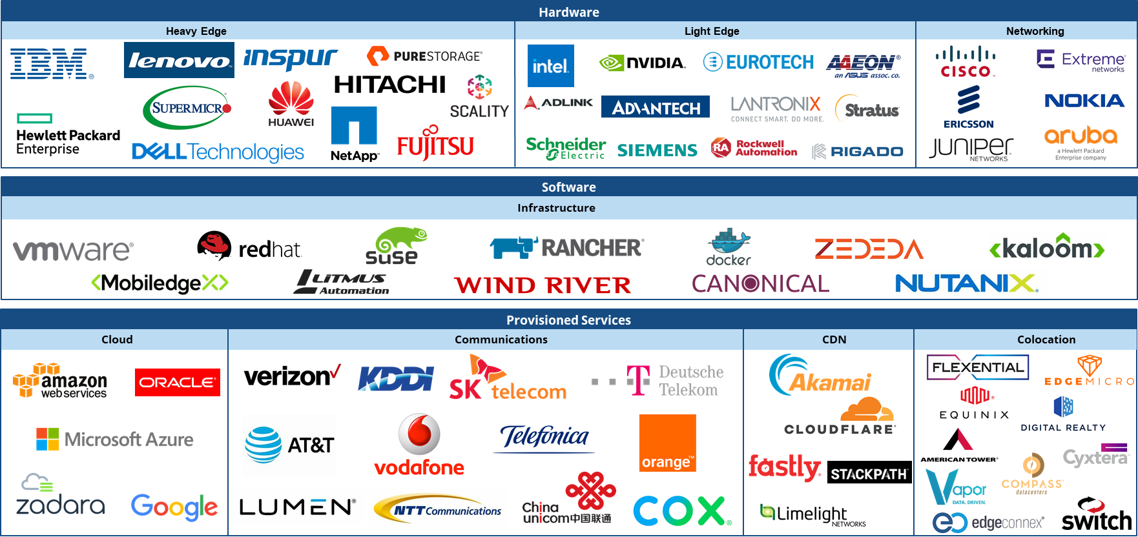
IDC Market Glance: Edge Infrastructure Segment Definitions
Hardware
Heavy Edge
Heavy edge computing platforms are meant to perform sophisticated computing tasks but adapted for the edge location or deployment.
These platforms are usually a variant of core general-purpose computing platforms (servers) that are built with datacenter-grade industry-standard components, feature ruggedized packaging, and onboard control and data acquisition hardware.
Light Edge
Light edge platforms — also known as edge gateways — are designed with low-power components (such as fanless processors and low-power memory and flash).
Most of these devices are designed for running limited or single functions in environments wherein power and cooling availability is limited with a diverse set of form factors.
Networking
Equipment that is primarily deployed to build and support the local, wide, or wireless networks that facilitate core-to-edge communications.

Slide 5
IDC Market Glance: Edge Infrastructure Segment Definitions
Software
Infrastructure
Systems infrastructure software includes solutions that provide the basic foundational layers of software that enable bare metal infrastructure hardware resources to host higher-level application software.
This software provides the virtualization, container, orchestration, and management software used to configure, control, automate, and share the use of those resources across heterogeneous applications and user groups.

Slide 6
IDC Market Glance: Edge Infrastructure Segment Definitions
Provisioned Services
Cloud
Public cloud services are shared among unrelated enterprises and/or consumers, open to a largely unrestricted universe of potential users, and designed for a market, not a single enterprise.
Private cloud represents a pool of resources that are shared within a single enterprise.
Communications
This includes communications services by a network operator to connect edge and endpoints to core infrastructure.
Depending on the edge deployment scenario, there is a mix of fixed data services (Ethernet, MPLS, digital leased lines) and mobile services (LPWAN, LTE, 5G).
CDN
A content delivery network (CDN) facilitates the secure and timely delivery of content to end users within well-established performance and quality-of-service metrics.
A CDN is typically architected with a geographically dispersed network of cache or proxy servers, deployed centrally and in edge servers.
Colocation
Colocation services are defined as a customer's use of a third party's datacenter facilities (i.e., physical floor/cage/rack space, network capacity, and HVAC/power infrastructure).

